Slide 1
CS447/647
Storage LVM and RAID

Slide 2
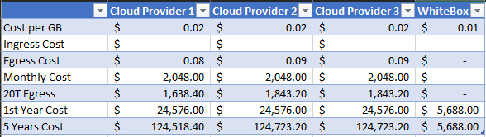

Slide 3
References
Nemeth, Evi, et al. UNIX and Linux System Administration Handbook. Addison-Wesley, 2018.
Remzi H., et al. Operating Systems: Three Easy Pieces, Arpaci-Dusseau Books, August, 2018 (Version 1.00) https://pages.cs.wisc.edu/~remzi/OSTEP/

Slide 4
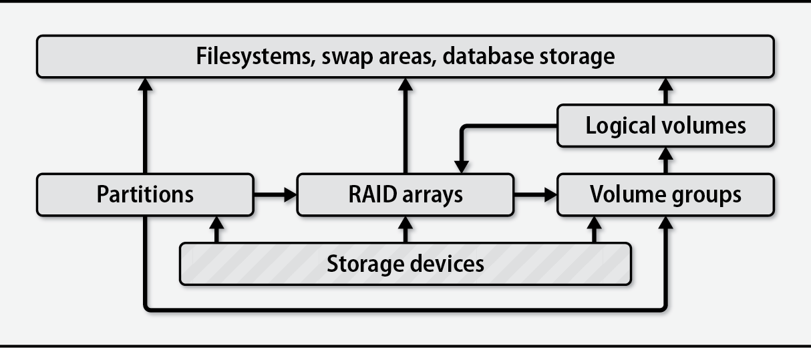

Slide 5
LVM - Logical Volume Management
Provides tools to create virtual block devices from physical devices
Virtual devices are easier to manage than physical devices
Three requirements
Device-mapper kernel module
Userspace device-mapper
Userspace lvm2 tools
Three components
Physical Volume
Volume Group
Logical Volume

Slide 6
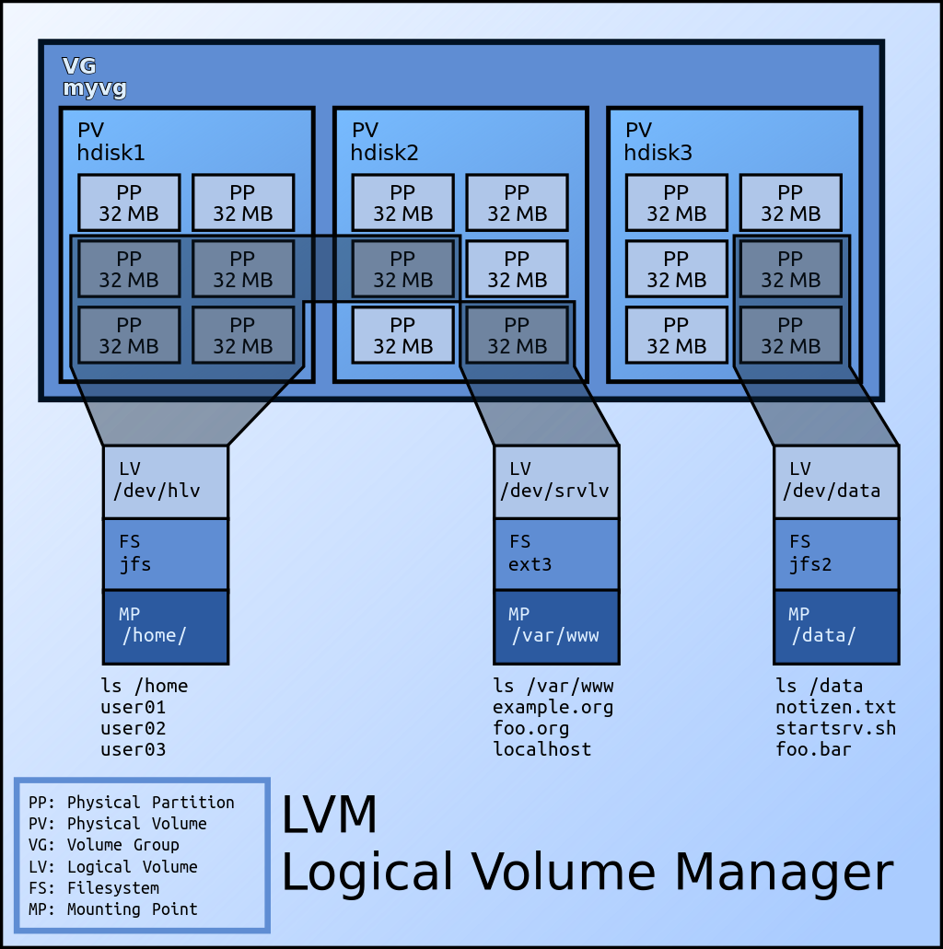
https://en.wikipedia.org/wiki/Logical_Volume_Manager

Slide 7
LVM - Userspace Basics
truncate -s 5G disk1.img truncate -s 5G disk2.img losetup -d /dev/loop0 losetup --find --show disk1.img losetup --find --show disk2.img parted -s /dev/loop0 'mklabel gpt mkpart lvpart1 1M 1G' parted -s /dev/loop1 'mklabel gpt mkpart lvpart1 1M 1G' pvcreate -v /dev/loop0p1 pvcreate -v /dev/loop1p1 pvdisplay

Slide 8
LVM - Userspace Basics
vgcreate vg0 /dev/loop0p1 vgextend vg0 /dev/loop1p1 vgdisplay lvcreate -L 1.5G -n lv0 vg0 lvdisplay parted -s /dev/mapper/vg0-lv0 'print' lvresize -L -.5G vg0/lv0 #Shrink lvresize -L +.5G vg0/lv0 #Grow

Slide 9
LVM - Userspace Physical Volume Moves
truncate -s 5G disk3.img losetup --find --show disk3.img parted -s /dev/loop2 'mklabel gpt mkpart lvpart1 1M 1G' pvcreate -v /dev/loop2p1 pvmove /dev/loop0p1 /dev/loop2p1 pvdisplay -m

Slide 10
LVM - Userspace Snapshots
pvcreate /dev/loop0 pvcreate /dev/loop1 vgcreate vg0 /dev/loop0 /dev/loop1 lvcreate -L 1G -n lv0 vg0 mkfs.ext /dev/mapper/vg0-lv0 mount /dev/mapper/vg0-lv0 /mnt touch /mnt/file lvcreate -L1G -s -n lv0-snap vg0/lv0 #Create a snapshot named lv0-snap umount /mnt mount /dev/mapper/vg0-lv0--snap /mnt umount /mnt && lvremove vg0/lv0-snap

Slide 11
RAID
We often want disks to be
faster
larger
more reliable
Redundant Array of Inexpensive Disks (RAID)
Developed in the late 1980’s by the CS department at Berkeley
Technique to make multiple disks to appear as a single disk
More storage, better performance and reliability
Complex
Multiple Disks
RAM
Processors

Slide 12
RAID
Advantages
Performance
Capacity
Reliability
Redundancy - Tolerate the loss of a disk
Transparency - Easing Deployment
New functionality
Demands no changes to the rest of the system
RAID is a perfect example
Looks like one big disk
Solved the deployment problem

Slide 13
Interface and RAID Internals
Filesystem sees one big disk
When a logical IO request is made, a RAID must:
Calculate which disk
Issue physical IO request
Mirroring results is 2 physical writes for 1 logical
SATA, SCSI or NVME
NVME is software RAID only
mdraid
Hardware RAID for SATA and SCSI

Slide 14
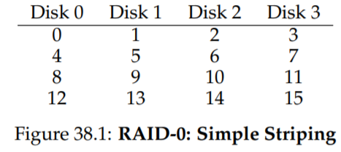
RAID0 - Striping
Upper Bound of Performance and Capacity
“Perfect reliability”
One disk fails the whole array fails
Excellent Performance
All disks are utilized
Often parallel
Best Capacity
All Disks combined

Slide 15
RAID Mapping Problem
How does the RAID map logical blocks to physical disks?
Logical Block A
Disk = A % number_of_disk
Offset = A / number_of_disks
So, a write to A = 14 with a 4 disk RAID
Disk: 14 % 4 = 2
Offset: 14 / 4 = 3

Slide 16
Chunk Size
Affects performance
64Kb, 512Kb (common)
Group blocks together on a single disk
Small chunks means files are striped across many disks
Large chunks reduce intra-file parallelism
Art more than a science

Slide 17
RAID0 - Performance
Sequential Workload - Large continuous chunks
Random Workload - Small requests for random disk locations (blocks)
Databases
In general Sequential > Random
Number of Disks * Random Rate
Number of Disks * Sequential Rate
Full Bandwidth

Slide 18
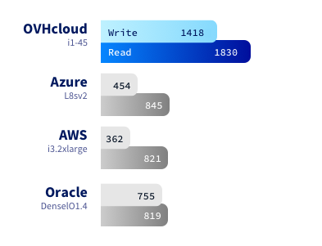
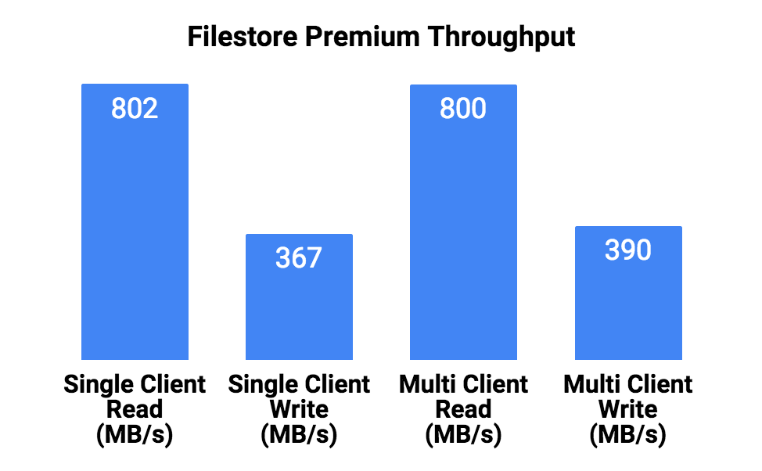
How do we benchmark?
dd(1) - Basic Sequential Read\Write
hdparm(1) - Basic buffered reads test
fio(1) - synthetic benchmarks, ‘real world’ workloads
$0.624/h

Slide 19
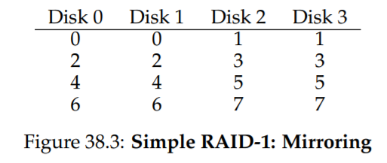
RAID1 - Mirroring
Copy of each block on a different disk
Each logical write is two physical writes
Slowest of the two
Happen in parallel
Sequential Performance: (N/2) * Sequential Rate
Random Performance: (N/2) * Random Rate

Slide 20
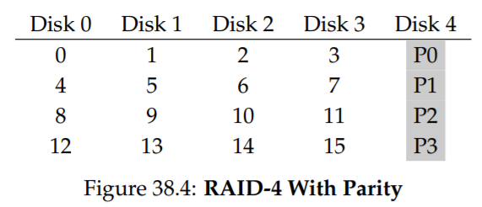
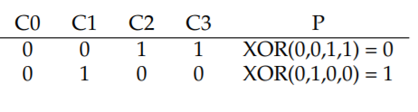
RAID4 - Parity
Each stripe has a parity block
Parity calculated using XOR
Can lose 1 disk
Replacement has to be rebuilt
Performance
(N - 1) * Rate
Random write does not improve when you add disks

Slide 21
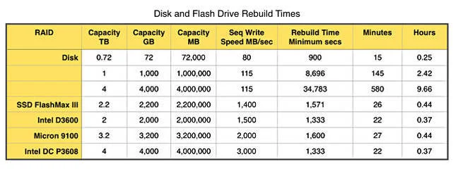
https://www.theregister.com/2016/05/13/disak_versus_ssd_raid_rebuild_times/

Slide 22
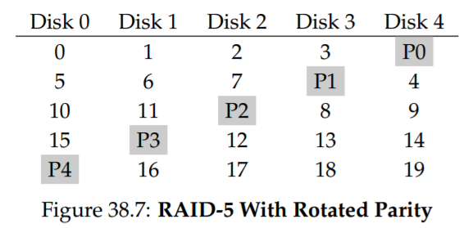
RAID5 - Rotating Parity
Operates identically to RAID4
Random read performance slightly better
Random Write: (N/4) * R

Slide 23
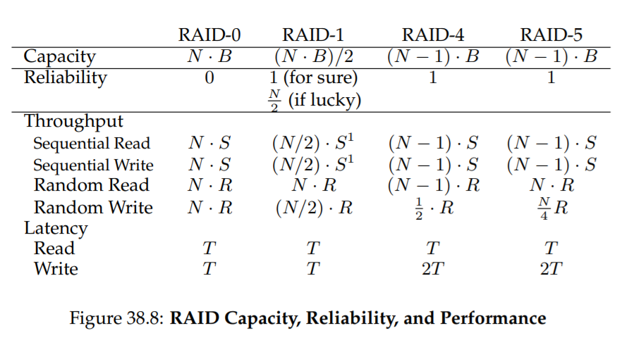

Slide 24
mdraid - Linux Software Raid
RAID devices are virtual devices created from two or more block devices
Many devices to one virtual device
RAID Levels offer performance and redundancy
Levels
LINEAR - concatenates devices in a single device. Like LVM Volume Group
RAID0 (striping) - No redundancy, performance RAID1 (mirroring) - Mirror disks
RAID4 - RAID0 plus a parity disk
RAID5 - RAID4 with parity spread across disks, lose 1 disk
RAID6 - RAID5 with two parity segments, lose two disks
RAID10 - striped mirroring
MULTIPATH - Not a RAID. Multiple paths to same storage device. iSCSI
FAULTY - provides a layer over a true device that can be used to inject faults
CONTAINER - Set of devices

Slide 25
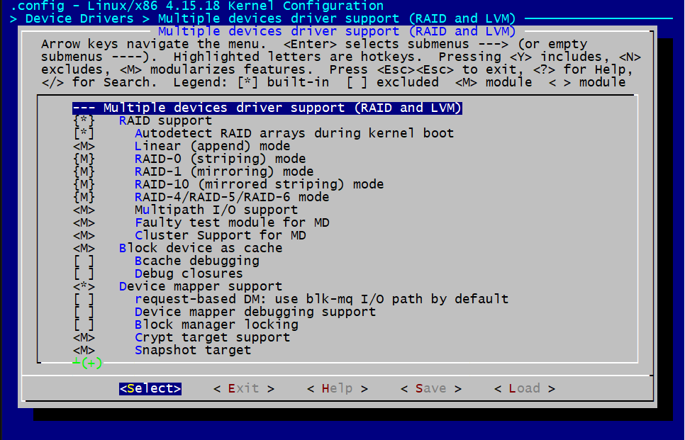

Slide 26
mdadm
mdadm -C /dev/md0 -l stripe -n 2 /dev/loop0 /dev/loop1 #RAID0 mdadm -C /dev/md0 -l raid1 -n 2 /dev/loop0 /dev/loop1 #RAID1 #RAID5 mdadm -C /dev/md0 -l raid5 -n 3 /dev/loop0 /dev/loop1 /dev/loop2 -x 1 /dev/loop3
mdadm --detail /dev/md0 cat /proc/mdstat
#Persist across reboots mdadm --detail --scan --verbose > /etc/mdadm.conf

Slide 27
mdadm
mdadm -C /dev/md0 -l raid1 -n 2 /dev/loop0 /dev/loop1 #RAID1 #Fail a disk mdadm --fail /dev/md0 /dev/loop0 mdadm --remove /dev/md0 /dev/loop0 mdadm --add /dev/md0 /dev/loop0

Slide 28
mdadm
#Fake Corruption
dd if=/dev/zero of=/dev/loop0 bs=1M count=128 echo check > /sys/block/md0/md/sync_action cat /proc/mdstat

Slide 29
drbd
Distributed Replicated Block Device
High-Availability Storage
RAID1 over the network
Active/Passive Setup

Slide 30
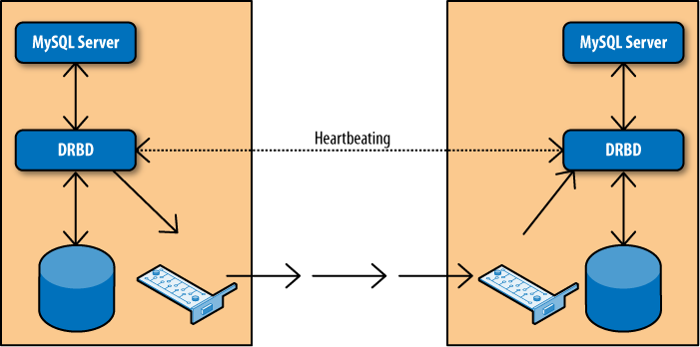
MySQL High Availability

Slide 31
drbd
# begin resource drbd0
resource drbd0 { protocol C; startup {degr-wfc-timeout 120;} disk {on-io-error detach;} net {} syncer { rate 100m; al-extents 257; } on server1 { device /dev/drbd0; disk /dev/sdb; address 192.168.1.230:7788; meta-disk internal; } }
on server2 { device /dev/drbd0; disk /dev/sdb; address 192.168.1.231:7788; meta-disk internal; }

Slide 32
DRBD
apt install -y drbd-utils mkdir -p /srv/drbd && cd /srv/drbd truncate -s 1G res0.img losetup --show --find res0.img #Create /etc/drbd.d/drbd0.res drbdadm create-md drbd0 drbdadm up drbd0 cat /proc/drbd drbdadm primary --force drbd0

Slide 33
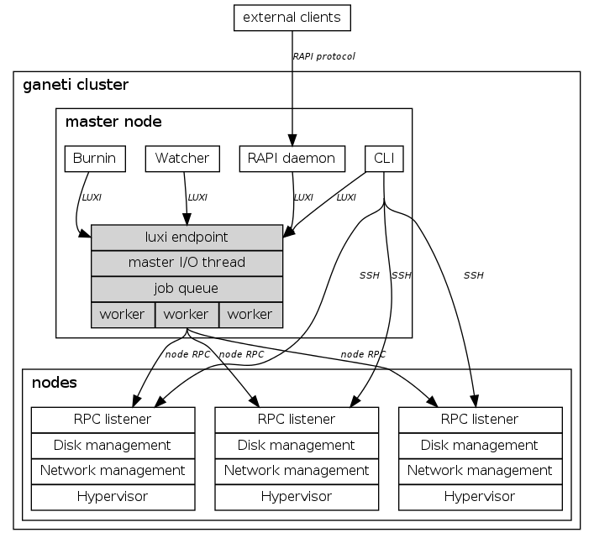
Why does this matter?
Complex container and virtual machine managers use LVM, mdadm and drbd extensively. They are heavily scripted.

